Slide 1
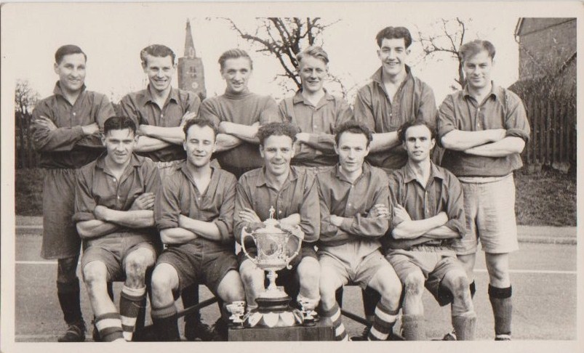
Darkie Barns Adgy Gibbard Stan S ??? Barry Tustian Reg Bennett Dave Gibbard
Len Fox Stan Baker Ray Newman Bobby Christie
BYFIELD BETHEL CUP WINNERS

